Slide 1
Trading Research/Strategy
Umar Sabir

Slide 2
Problem
Financial markets are very risky
Most traders want to limit market exposure
Day trading requires an account balance of $25,000

Slide 3
Strategy
Buy right before market closes and sell right when the market opens
Limits market exposure
Doesn’t break Day trading rules

Slide 4
Tools used
Python
Statsmodels SARIMAX model
Pandas
numpy
yfinance

Slide 5
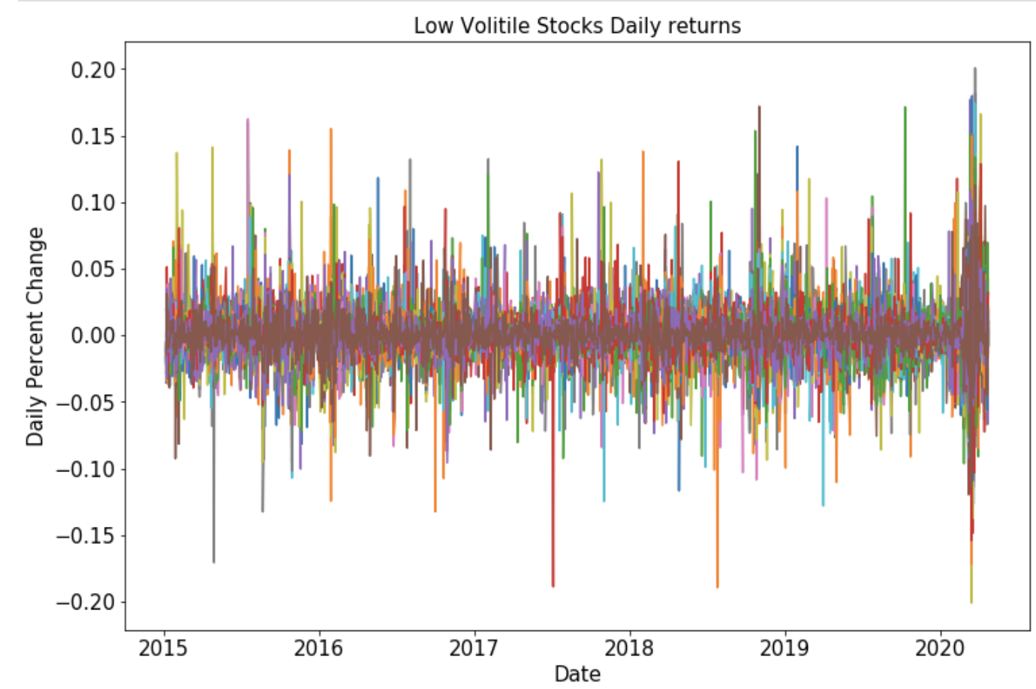
Initial EDA
Split my 100 stocks based on standard deviation
3 groups

Slide 6
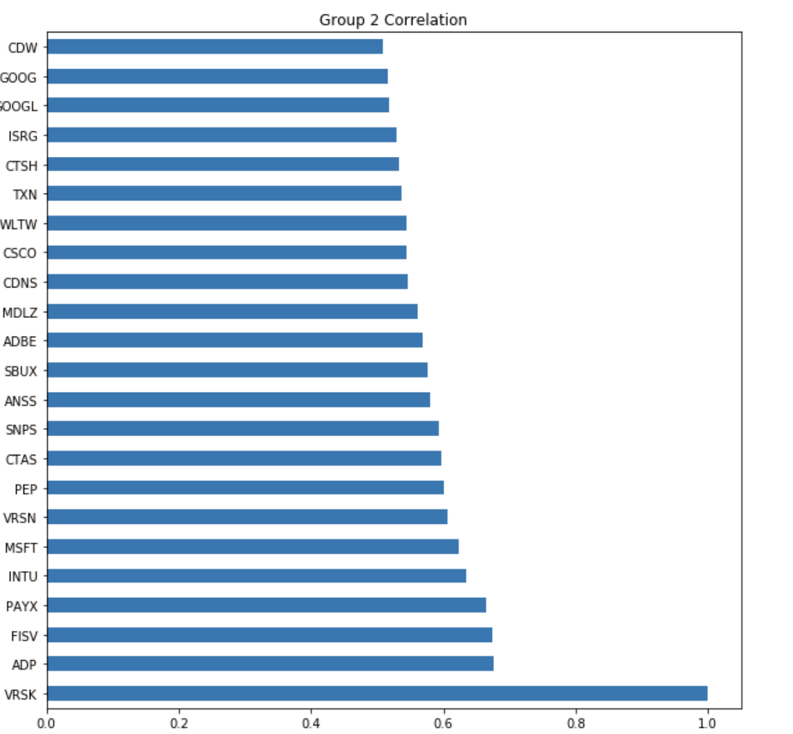
Correlation groups
What are correlation groups
How did I make them
How can I use them

Slide 7
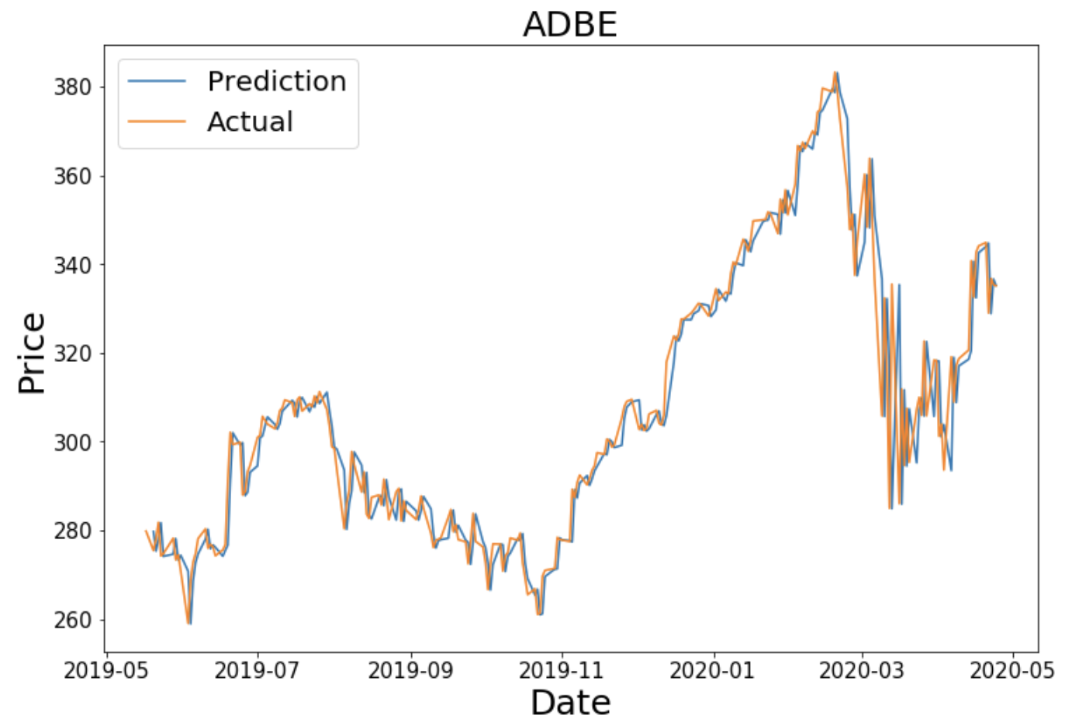
ADBE
ADOBE
params
RMSE of $8.20

Slide 8
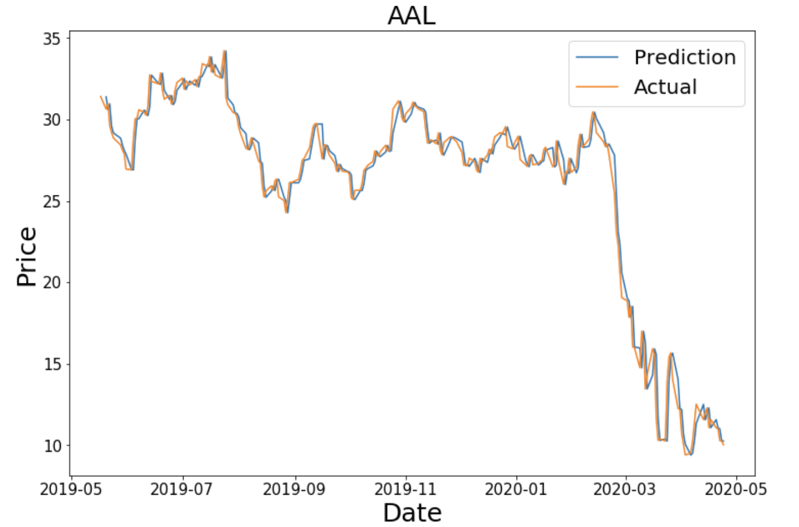
AAL
American Airlines
RMSE 89 cents

Slide 9
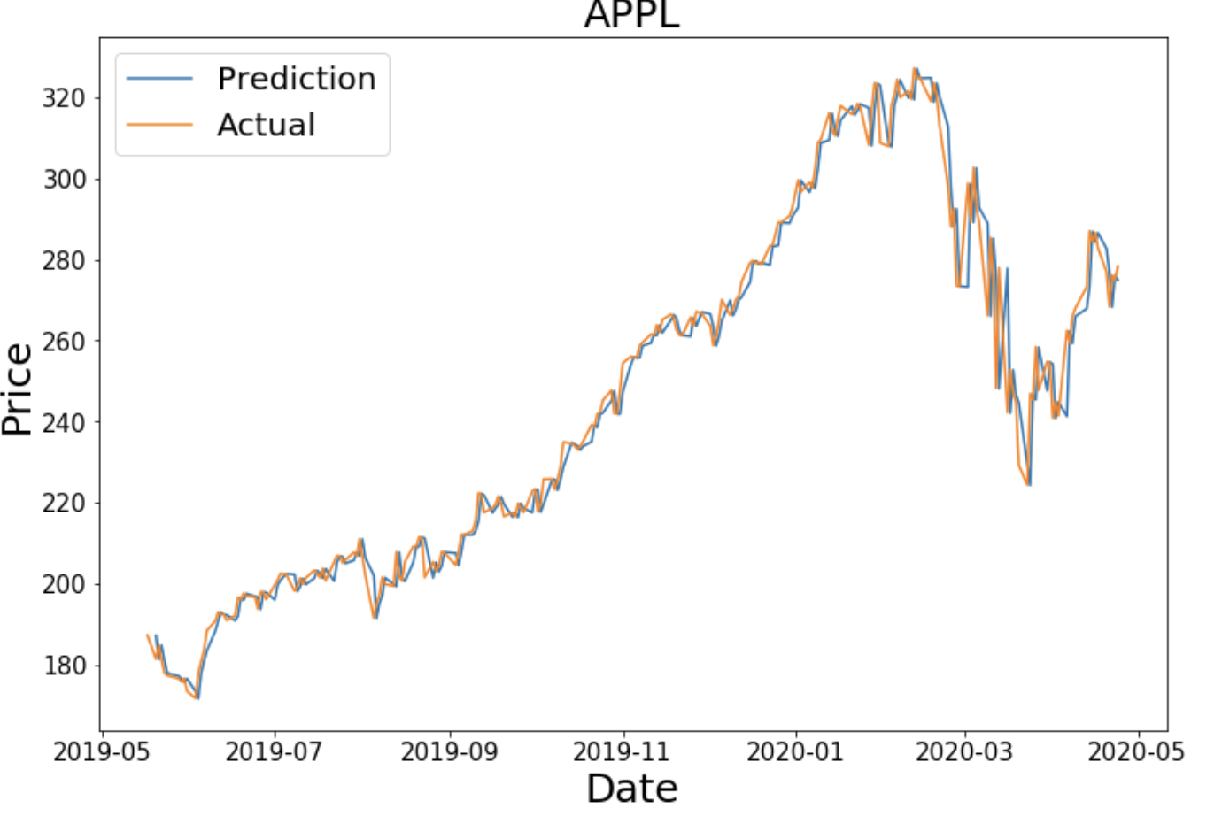
AAPL
APPLE
RMSE $6.67

Slide 10
Future work
Improve on my baseline models
Create predictions 1 day out
If I have time create lstm predictions and clustering algorithim

Slide 11
Thank you

